Slide 1

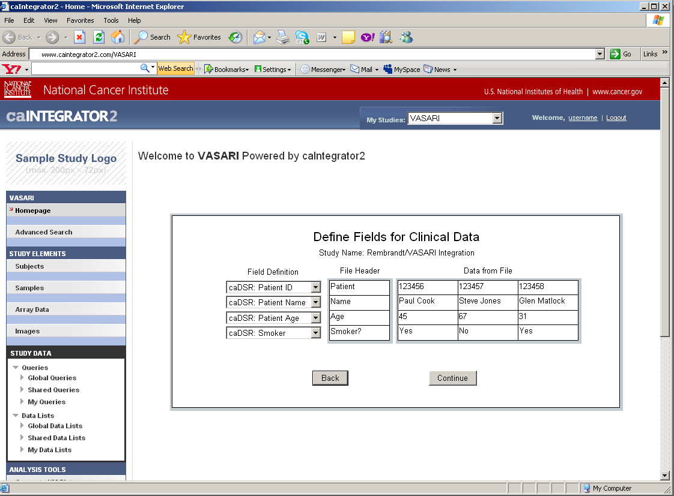
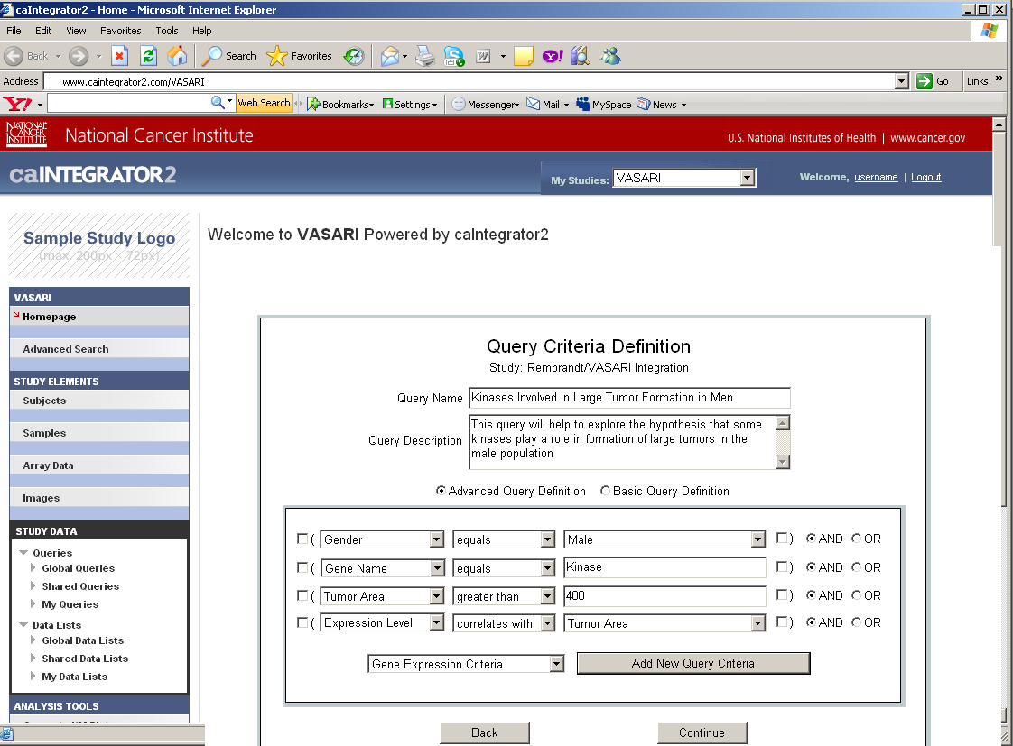

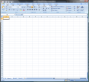

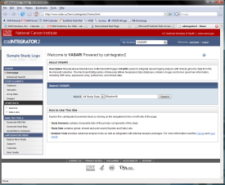
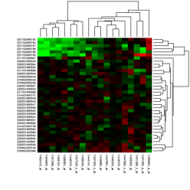
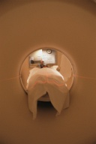
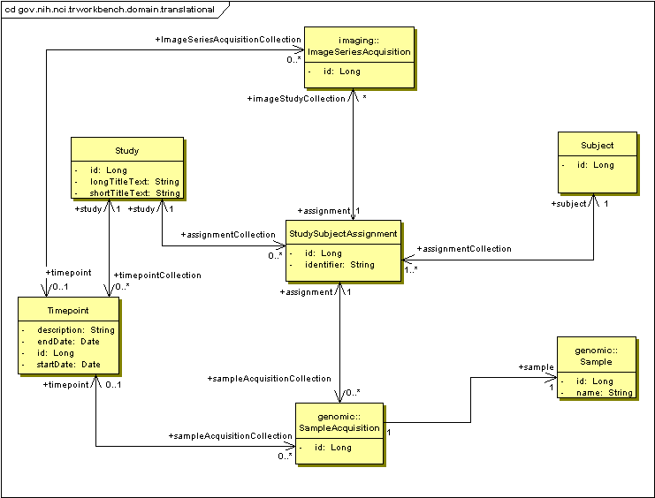
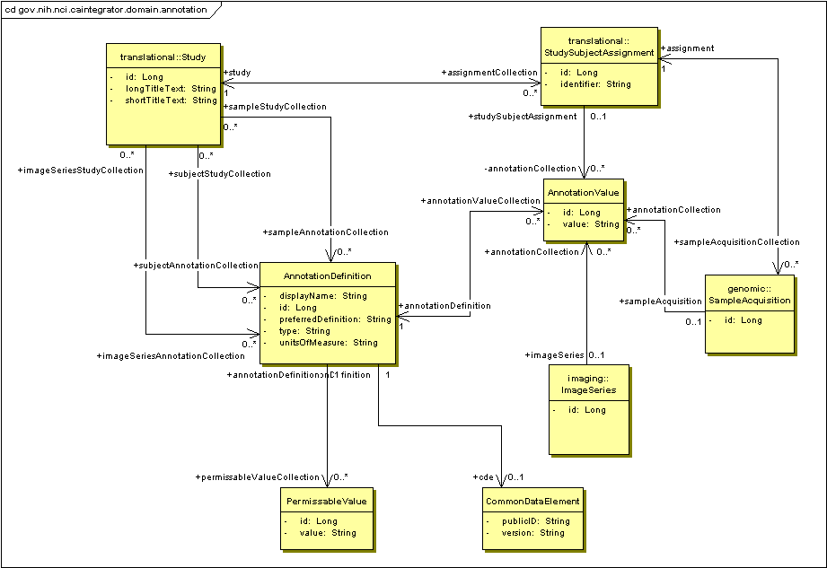


Vasari: Integration of Neuroimaging analysis with clinical-genomic data in Rembrandt
Himanso Sahni, MS, SAIC; Adam Flanders, MD, Thomas Jefferson University Hospital; Lori Dodd, ??, NCI; Eliot Siegel, MD, University of Maryland Medical Center; Daniel Rubin, MD/MS, Stanford University Medical Center; John Freymann, ??, NCI; Carl Jaffe, PhD, NCI; Subha Madhavan, PhD, NCI, Anand Basu, ??, NCI; Yuri Kotliarov, ??, NCI; TJ Andrews, MS, ScenPro; William FitzHugh, MS, 5AM Solutions; Michael Holck, BS, ScenPro; Shine Jacob, ??, 5AM Solutions, Eric Tavela, ??, 5AM Solutinos, Matt Rehfuss, ??, 5AM Solutions.
Abstract
Web Interface
Vasari is the integration of Neuroimaging analysis with clinical and functional genomics data from clinical trials involving patients suffering from Gliomas in REpository for Molecular BRAin Neoplasia DaTa (REMBRANDT) repository. Vasari will provide researchers with the ability to perform ad hoc querying and reporting of Neuroimaging analysis across multiple data domains, such as Gene Expression, Chromosomal aberrations, and Clinical data. Via Rembrandt, researchers will also be able to view or download the annotated imaging data stored at the National Cancer Imaging Archive (NCIA) repository.
Use Cases
CTODS
(Clinical Trials Object Data System)
Deploy Study: This page allows the Study Manager to map each uploaded clinical data field to a caDSR datatype. If there is no existing caDSR datatype then a local caIntegrator2 datatype can be defined instead.
Manage Queries: This page allows the Study Manager to create queries that can be shared with all researchers who have access to the study. These queries can access all fields from all data sources and complex queries can be built up from logical combinations of simpler queries. The queries can also look for correlation relationships such as genes that are up-regulated in a certain tumor type determined by imaging.
Clinical Data
OR
caIntegrator2
Clinical Annotation Spreadsheet
caArray
Data Model
Genomic Data
(mRNA expression, array CGH)
NCIA
(National Cancer Imaging Archive)
Image Annotation Spreadsheet
Patients in Study
Imaging Data
Deploy Study: The Study Manager defines the sources of data for a new study. The data is then accessed over the Grid or uploaded from files. The Study Manager defines relationships between patients and samples so that data can be compared properly across the data sources. The Study Manager also defines mapping of uploaded annotation fields to caDSR datatypes.
Focus on Interaction
Translation Data Model: This object model shows the relationship between study subjects (patients) and the genomic and imaging data that is acquired from them. In addition, multiple timepoints can be defined for a study so that imaging and genomic data can be gathered multiple times. An example of timepoints would be ‘At Diagnosis’ and ‘After Treatment’.
Annotation Data Model: This object model shows how annotations are stored. Annotations can be associated with patients, genomic samples and image series. The Common Data Element object defines a relationship with a caDSR datatype if an appropriate one can be found.
caBIG™ Annual Meeting June 23-25, 2008, Washington DC

